Slide 1
Bank Term Deposits
David Ocampo

Slide 2
Overview
Current Data
Building a Model
Take Aways
Questions

Slide 3
CURRENT DATA

Slide 4
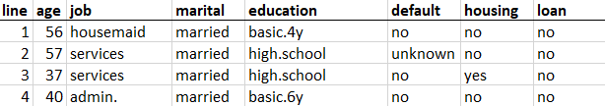
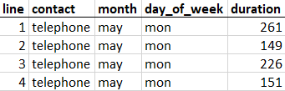
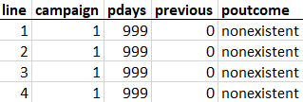
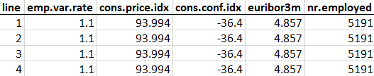
Current Data Set

Slide 5
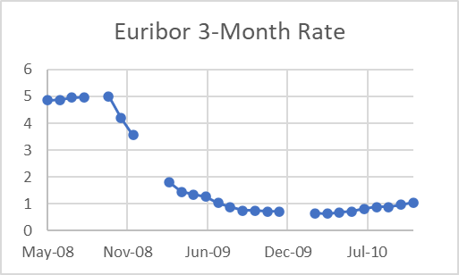
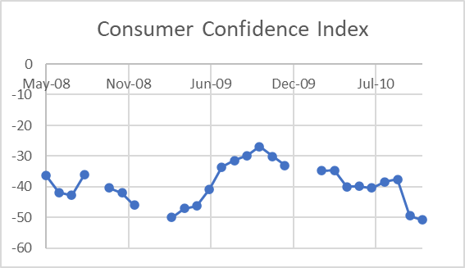
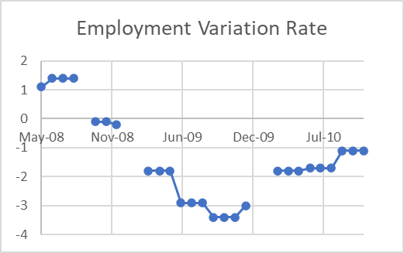
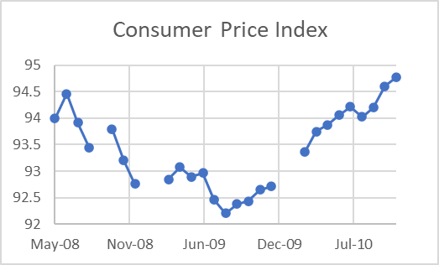
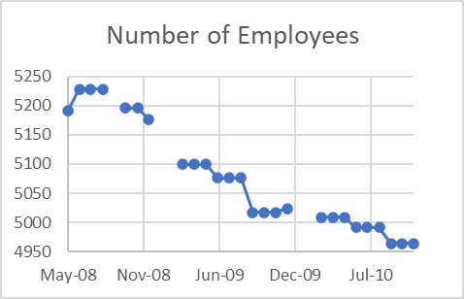
Economic Background
May 2008 to November 2010
Five sets of economic data
Recession

Slide 6
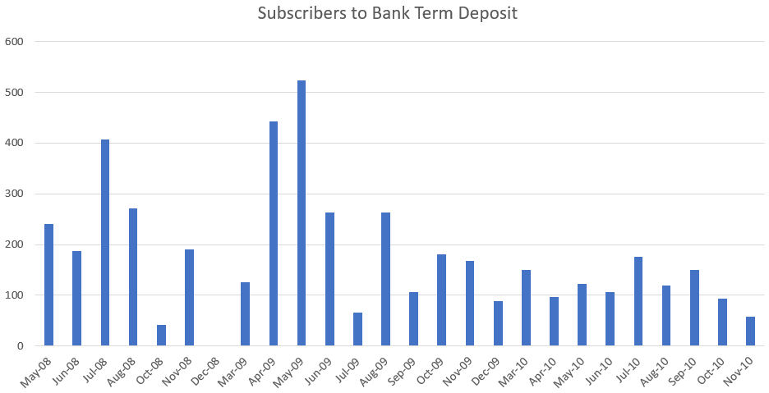
Term Deposits

Slide 7
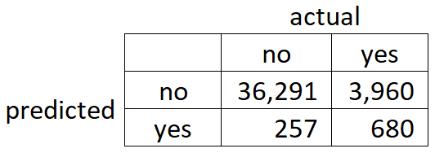
Current Model
Output: Predicts if customer subscribed to bank term deposit
Accuracy: 89.76%

Slide 8
BUILDING A MODEL

Slide 9
Software
RStudio
Open source software – free
Make changes to data without affecting database
Create repeatable process
Split data into 2 sets
Train data (random 70%)
Test data (random 30%)

Slide 10
Cleaning Data
Cleaned values within “pdays” and “previous” variables
Most values are 999 for “pdays”
Removed columns
Duration and Model Prediction
Columns similar to other columns
Columns not statistically significant

Slide 11
Built Model
Utilize a Generalized Linear Model (GLM)
Results are almost identical to current model
Current Model: 89.76% New Model: 89.95%
Significant data:
Type of Job
Credit in Default
Number of Contacts Performed for this Campaign
Outcome of Previous Marketing Campaign
Employment Variation Rate
Consumer Confidence Index

Slide 12
TAKE AWAYS

Slide 13
Take Aways
Data has many unknown values
Previous Outcome Success greatly influences term deposits
Concentrate efforts on Customer Relations
Students and Retirees like Term Deposits
Model accuracy stays the same, but better understanding of data

Slide 14
QUESTIONS

Slide 15
Technical Backup Slides

Slide 16
R Script
bankDataSet <- read.csv("C:/Users/david/Desktop/DSA Data Set.csv")
#fix skewed data for "pdays" and "previous"
bankDataSet$pdays[bankDataSet$pdays == 999] <- NA
bankDataSet$previous[bankDataSet$previous == 0 ] <- NA
summary(bankDataSet)
#take out columns
bankDataSet <- bankDataSet[-c(1,4,8,9,10,11,13,14,17,19,20,21)]
#create test and train data for generalized linear model
set.seed(100)
ind <- sample(2,nrow(bankDataSet),replace = TRUE,prob = c(.7,.3))
train.data <- bankDataSet[ind == 1, ]
test.data <- bankDataSet[ind == 2, ]
#scatterplot matrix for multicollinearity test. Took out cons.price.idx due and euribor3m
data = data.frame(test.data)
plot(data)
#initial look at model variables
bankFormula <- y~.
model <- glm(bankFormula,family=binomial,data=train.data)
summary(model)
#including only variables with p < .05
bankFormula <- y~job+default+campaign+poutcome+emp.var.rate+cons.conf.idx
model <- glm(bankFormula,family=binomial,data=train.data)
summary(model)
#show stats for new model
trainTablePredictions <- table(round(model$fitted.values),train.data$y)
trainTableAccuracy <- (trainTablePredictions[1] + trainTablePredictions[4])/sum(trainTablePredictions)
testTablePredictions <- table(round(predict.glm(model,test.data, type="response")),test.data$y)
testTableAccuracy <- (testTablePredictions[1] + testTablePredictions[4])/sum(testTablePredictions)

Slide 17
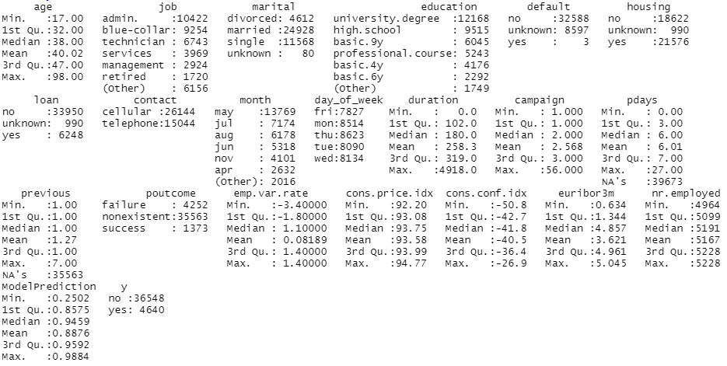
Summary of Data

Slide 18
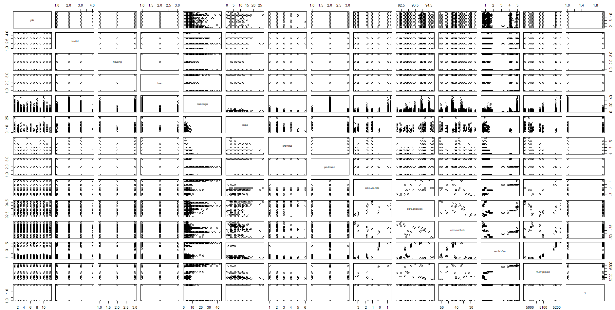
Test for Multicollinearity

Slide 19
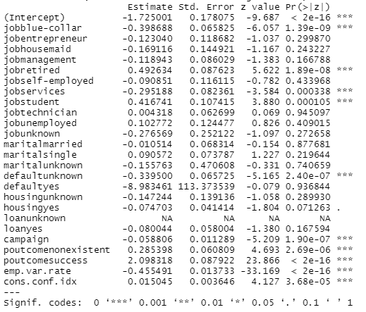
Summary of Model

Slide 20
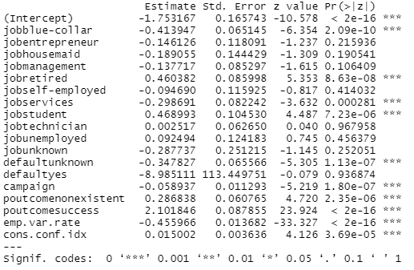
Significant Variables Model

Slide 21

Accuracy of Model

